Slide 1
Logic Programming with Prolog
CS4373: Artificial Intelligence Laboratory
A.Y. 2024-2025
Department of Computer Science and Engineering
National Institute of Technology Rourkela

Slide 2
Prolog - Introduction
Prolog or PROgramming in LOGics is a logical and declarative programming language.
This is particularly suitable for programs that involve symbolic or non-numeric computation.
Elements of Prolog Language
Facts − The fact is a predicate that is true; for example, if we say, “Tom is the son of Jack,” then this is a fact.
Rules − Rules are extinctions of facts that contain conditional clauses. To satisfy a rule, these conditions should be met.
Questions − To run a prolog program, some questions are needed, and the given facts and rules can answer those questions.

Slide 3
Environment Setup
This is the official GNU Prolog website where GNU Prolog can be downloaded.
Link. http://www.gprolog.org/
For 32 Bit System - http://www.gprolog.org/setup-gprolog-1.5.0-mingw-x86.exe
For 64 Bit System - http://www.gprolog.org/setup-gprolog-1.5.0-mingw-x64.exe

Slide 4


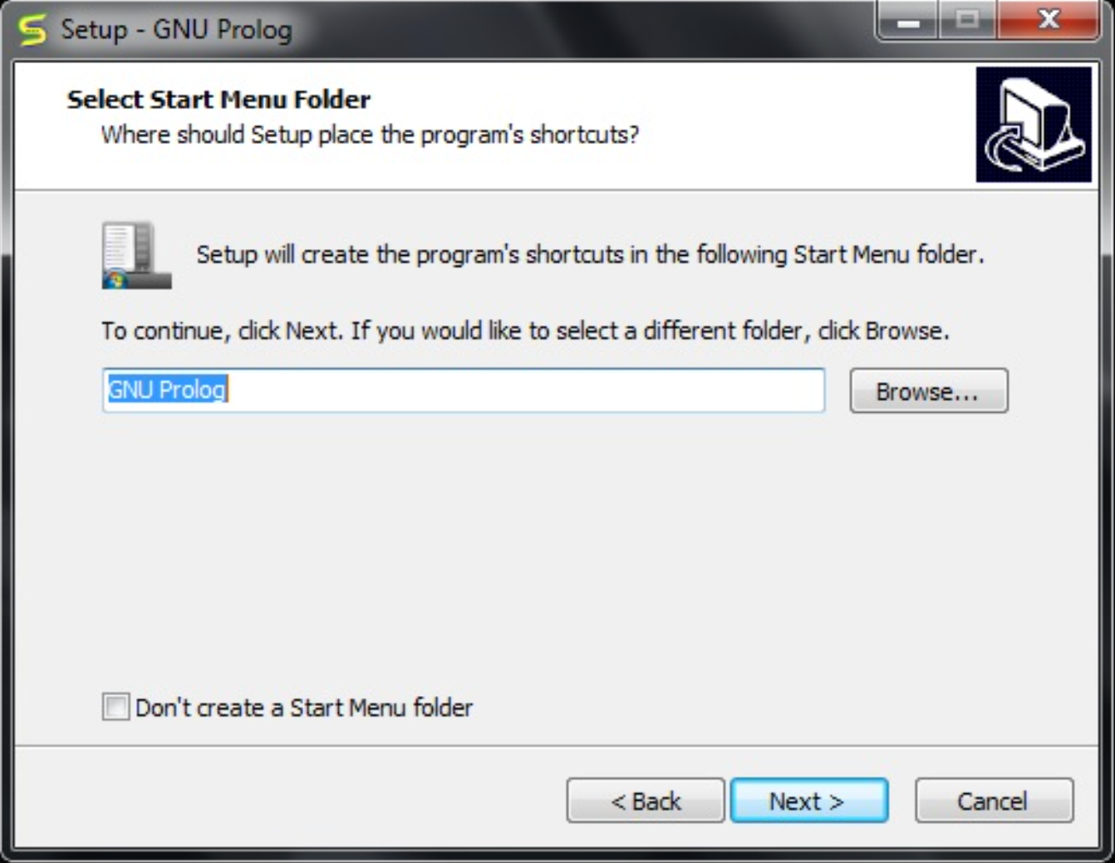

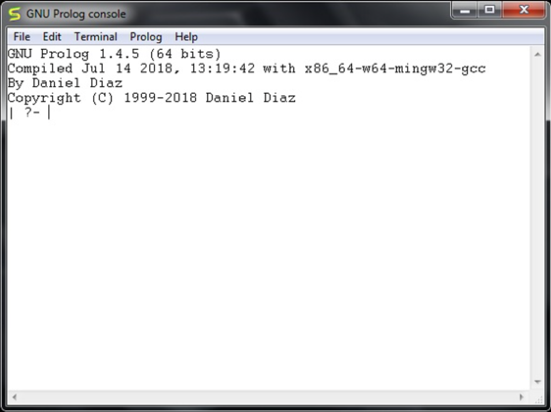




Slide 5

Starting Prolog
System Prompt (?-)
The prompt indicates that the Prolog system is ready for the user to enter a sequence of one or more goals, which must be terminated by a full-stop, e.g.,
In the above example, the user has entered a sequence of four goals:
write('Hello World'), nl (twice) and write('Welcome to Prolog').
The commas separating the goals signify 'and'.
The meanings of write and nl are pre-defined by the Prolog system. They are known as built-in predicates.
Two other built-in predicates are halt and statistics.
halt causes the Prolog system to terminate.
statistics causes system statistics.
The output of the above example ends with the word yes, signifying that the goal has succeeded.

Slide 6
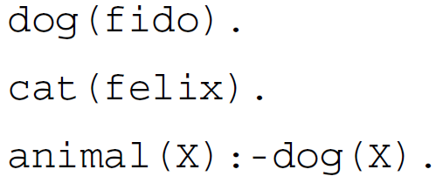
First Prolog Program
Let’s create a Prolog program, type it into a text editor, and save it as a text file, say Program1.pl.
To load the file, first change the directory using the command - change_directory('Path').
To load the file for use by the Prolog system using –
consult('Program1.pl').

Slide 7
In the above program, the three lines are called clauses.
Each clause is terminated by a full stop.
All clauses are either facts or rules.
dog(fido) and cat(felix) are examples of facts. They can be interpreted in a natural way as meaning 'fido is a dog' and 'felix is a cat'.
dog is called a predicate. It has one argument: the word fido is enclosed in ( ). fido is called an atom (meaning a constant that is not a number).
The final line of the program is the rule.
The :- character (colon and hyphen) can be read as 'if'.
X is called a variable.
In this context, X represents any value as long as it is the same value both times.
The rule can be read naturally as - 'X is an animal if X is a dog (for any X) '.
?- animal(fido). - yes/ no ?
?- animal(felix). - yes/ no ?

Slide 8
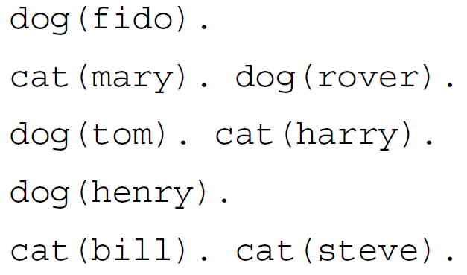
?- dog(X). - means 'find a value of X for which the goal dog(X) is satisfied', or 'find a value of X which is the name of a dog'.
?- dog(Y). - ???
?-listing(dog). - causes Prolog to list all four clauses defining predicate dog.
?-cat(X),dog(Y). - gives all possible combinations of a dog and a cat.
?-cat(X),dog(X). - ????

Slide 9
Recursion
To define predicates in terms of themselves. This is known as a recursive definition. There are two forms of recursion :
Direct recursion - Predicate pred1 is defined in terms of itself.
Indirect recursion - Predicate pred1 is defined using pred2, defined using pred3, …, defined using pred1.
The first form is more common. An example is :
likes(john,X):-likes(X,Y),dog(Y).
It can be interpreted as 'john likes anyone who likes at least one dog'.

Slide 10
Variables
Variables in Goals - can be interpreted as meaning 'find values of the variables that make the goal satisfied'. For example:
?-large_animal(A).
It can be read as 'find a value of A such that large_animal(A) is satisfied'.
Binding Variables – Initially, all variables used in a clause are said to be unbound, meaning that they do not have values. When the Prolog system evaluates a goal some variables may be given values such as dog, -6.4, etc. This is known as binding the variables.
Universally Quantified Variables - If a variable appears in the head of a rule or fact it is taken to indicate that the rule or fact applies for all possible values of the variable. For example :
large_animal(X):-dog(X),large(X).
It can be read as 'for all values of X, X is a large animal if X is a dog and X is large'. Variable X is said to be universally quantified.
Existentially Quantified Variables - if a variable, say Y, appears in the body of a clause but not in its head it is taken to mean 'there is (or there exists) at least one value of Y'. Such variables are said to be existentially quantified.

Slide 11
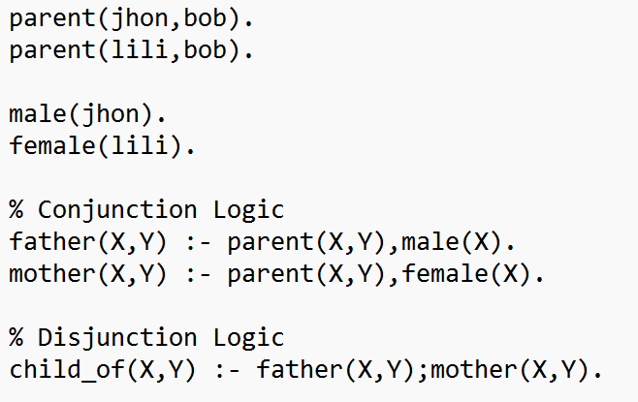
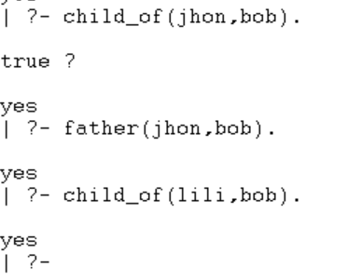
Conjunctions and Disjunctions
Conjunction- Conjunction (AND logic) can be implemented using the comma (,) operator. So two predicates separated by a comma are joined with AND statement.
Disjunction– Disjunction (OR logic) can be implemented using the semi-colon (;) operator. So two predicates separated by semi-colon are joined with OR statement.

Slide 12
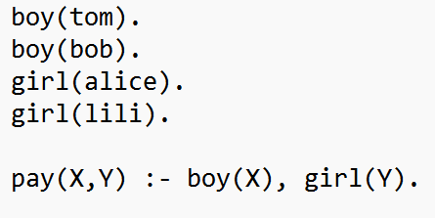
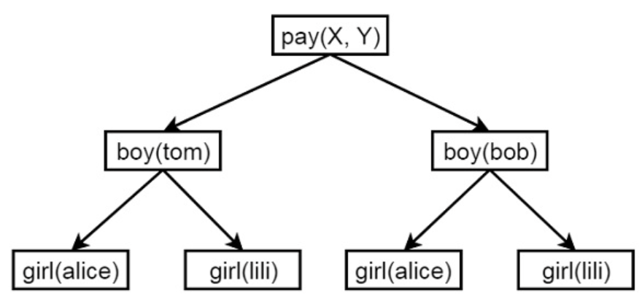
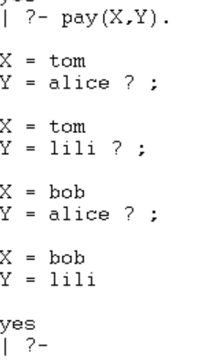
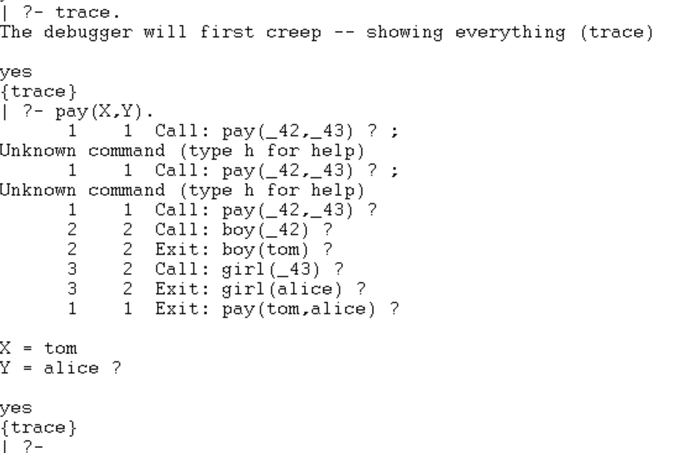
Backtracking
Backtracking is a procedure, in which prolog searches the truth value of different predicates by checking whether they are correct or not.
In Prolog, until it reaches proper destination, it tries to backtrack. When the destination is found, it stops.

Slide 13
Exercise -1
Write a program to put facts indicating that a lion, a tiger, and a cow are animals into the database and record that two (lion and tiger) are carnivores. Save your program to a disk file and load it. Check that the database is correct using the listing.
Enter goals to test whether:
(a) there is such an animal as a tiger in the database
(b) a cow and a tiger are both in the database (a conjunction of two goals)
(c) a lion is an animal and also a carnivore
(d) a cow is an animal and also a carnivore.
(e) list all animals which are also carnivores.

Slide 14
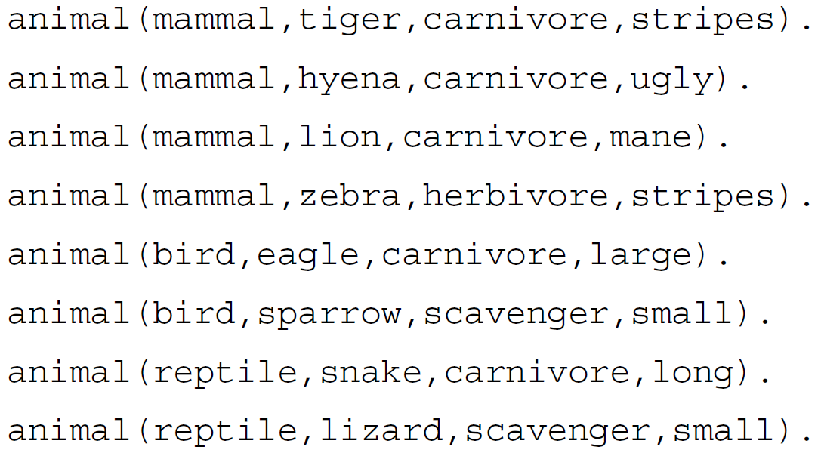
Exercise -2
Type the following program into a file and load it into Prolog.
Devise and test goals to find:
(a) all the mammals.
(b) all the carnivores that are mammals.
(c) all the mammals with stripes.
(d) whether there is a reptile that has a mane?

Slide 15
Exercise -3
Write a prolog program to infer the following first-order logic statements :
The law says that it is a crime for an American to sell weapons to hostile nations. The country Nono, an enemy of America, has some missiles, and all of its missiles were sold to it by Colonel West, who is American. Is West a criminal?

